Slide 1

Module 6 – Video 4
Second-Degree Price Discrimination: Versioning and Coupons
Professor Nico Voigtländer
Management 405: Module 6

Slide 2
OUTLINE of module 6
Simple vs. complex pricing
Direct price discrimination
  Perfect price discrimination (first degree)
  Segment pricing (third degree)
Indirect price discrimination (second degree)
    Versioning
  Coupons
Advanced pricing strategies
  Volume pricing with flat fee
  Two-part tariff
  Block pricing

Slide 3
Second degree price discrimination:
Versioning
Indirect price discrimination
Charge different price for different versions of the product
Conditions:
  Firm has market power
  Consumer groups with different willingness to pay for the product category (e.g., flights)
  Firm cannot identify the different groups of consumers

Slide 4
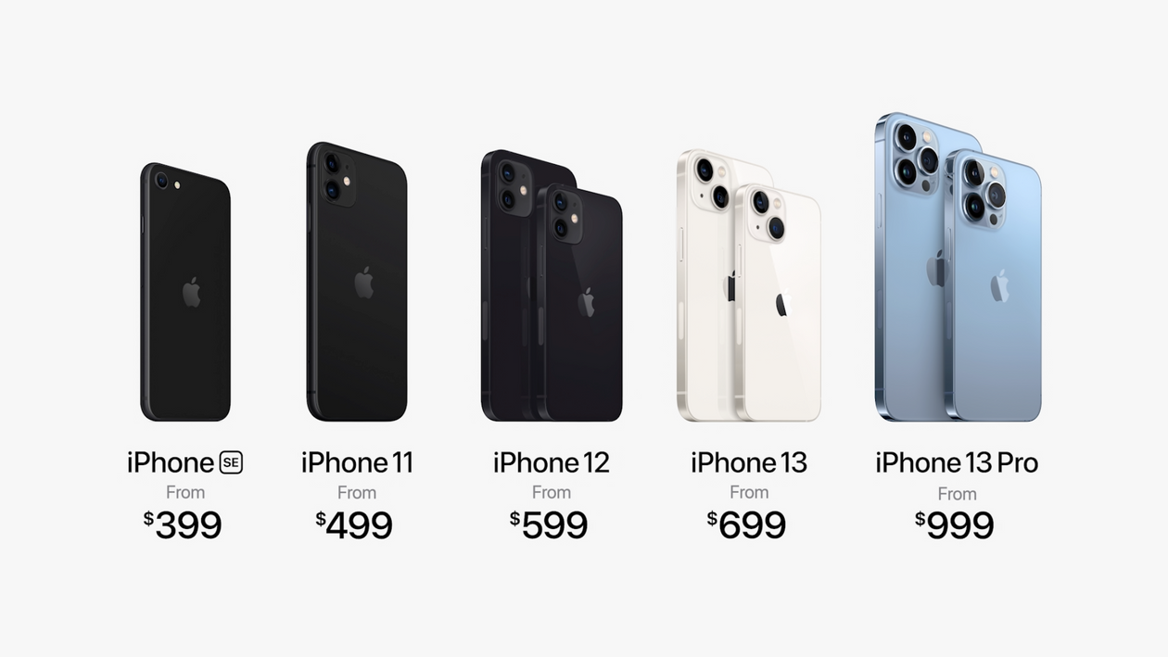
VErsioning
P/MPV
  Create different “versions” of your product
  Design them such that customers with different MPV “self-select” into the desired version
Version 1
P₁
Version 2
P₂
Version 3
P₃
Version 4
P₄
Version 5
P₅
demand

Slide 5
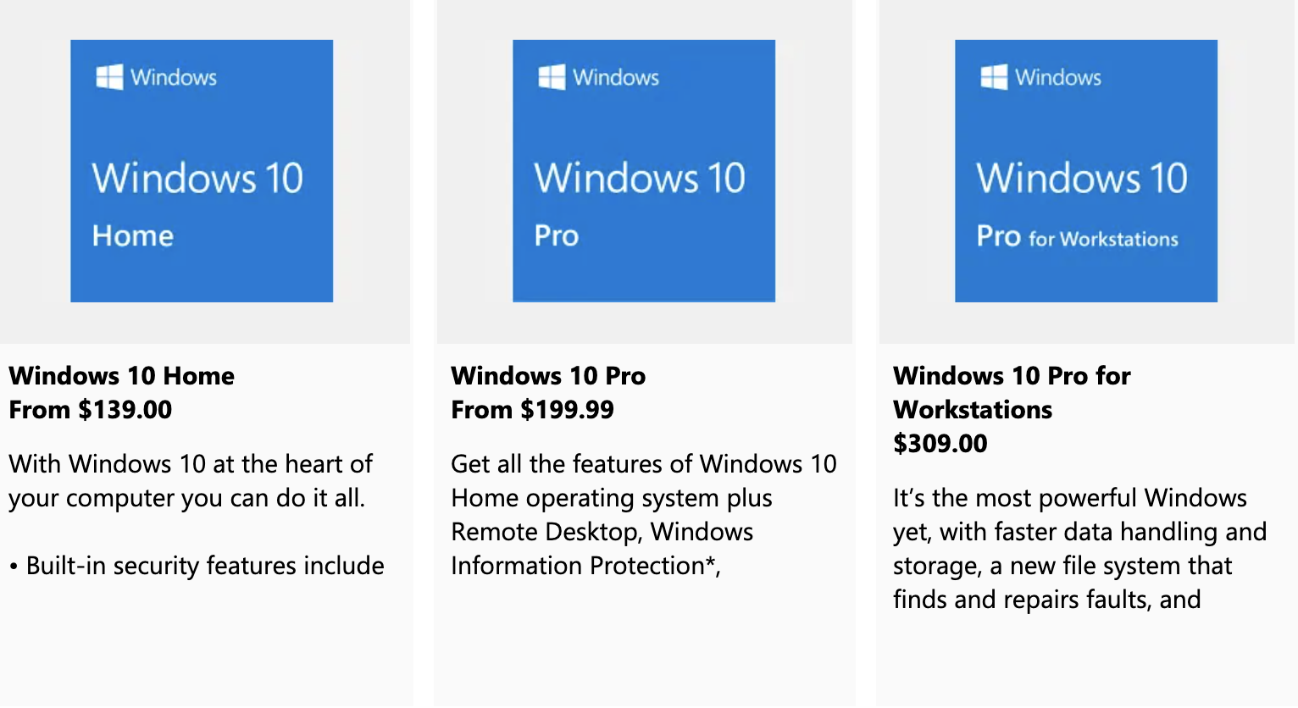
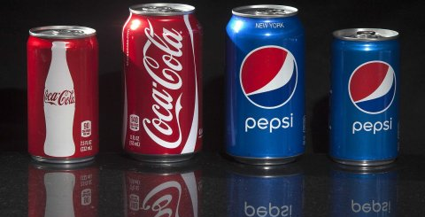
VErsioning
Offer a product line and let users sort themselves
Notes:
An example of Second Degree Price Discrimination: Versioning
We will go in greater depth into one form of second degree price discrimination which is versioning. Versioning is incentive compatible and accomplishes everything that price discrimination accomplishes. Consumers who buy at a high price do so willingly. The key to understand this is that the version priced at a premium has to have features that generate some value to the consumer, but the cost differential to the company is minor relative to the price differential (otherwise there is no real discrimination on price if the surplus captured is the same across segments).
The perfect example is Microsoft: offers Windows Professional and Windows Home Edition. Windows Pro has more features than Home edition but they are otherwise close substitutes. The marginal cost of producing each is identical (and approximately zero) – in fact it may cost the company something to actually differentiate the products. Sometimes it costs nothing to make something better but you don’t want to do it: why doesn’t Microsoft offer the full version of Windows to all their customers since the MC of doing so is zero? Because they would then join the markets, and forego the benefits of price discrimination. You add features to the price insensitive segment so you can charge them more.

Slide 6
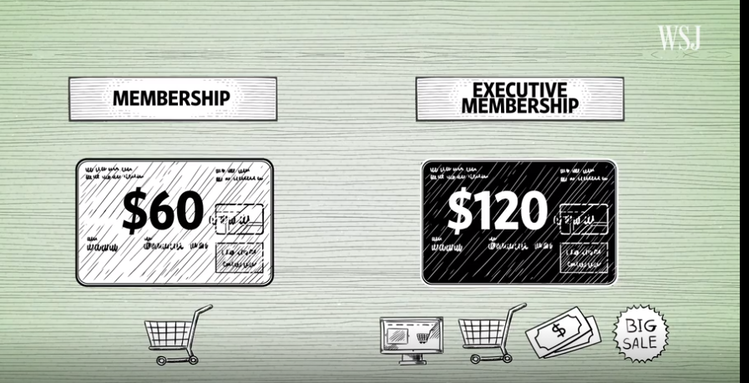
Versioning: Costco
Business model
  Make money on the memberships
  Sell goods at the cheapest price possible
  WSJ video on the strategic layout of Costco stores

Slide 7
More Examples for Versioning
Internet service: higher speed at a higher price
Fedex/UPS: ground vs. same-day delivery
Airlines: Business / premium economy / economy
Important note on versioning: Keep low-quality option inferior enough to prevent premium customers from being tempted
  This ensures “incentive-compatibility”
  So you don’t need to worry about resales

Slide 8
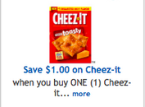
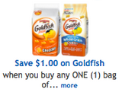
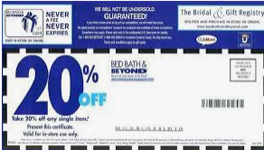
Second-Degree price Discrimination: coupons
Coupons ensure incentive-compatibility
Notes:
Checkout stand coupons: Nobody wants to spend money unnecessarily, but it takes time to sort through the coupons. Those who have nothing else to do on a Sunday morning, i.e. those with a low opportunity cost of time, who are price sensitive, will take the time to cut the coupons. This is an ingenious scheme to charge higher price to the low elasticity customers to capture more consumer surplus.
Another Example: Fun Film sold at Price Costco. This is a classic example. Kodak was selling their premium Royal Gold film. Fuji and others started competing. Kodak wanted to protect the low end of their market. They could have lowered the price on Royal Gold, but then you give up capturing the surplus at the high end. So they introduced a new brand, FunFilm, offered only at discount stores like Sam’s Club, Costco, in bulk. This is where price sensitive customers go. It turns out the two films were chemically identical. The packaging and bulk sales aspect were different but the actual product was the same. This is a classic B-school case.

